Slide 1
Cryptography
In Cyber Security
Satria Ady Pradana
2025

Slide 2





Who?
Satria Ady Pradana
Adversarial Engineer at Grab
Community Leader of Reversing.ID
Malware analyst and developer in my free time
Love low-level stuffs
IF ITB 2010 - Korlab Sister 2012 👈
xathrya
xathrya
@xathrya
@xathrya_

Slide 3
What is Adversary Simulation?
Another term for red-team operations.
Originate from military practices.
Evaluate security posture by posing as an attacker.
Attack simulation designed to measure how well organization’s security controls can withstand attacks from real-life adversaries.

Slide 4
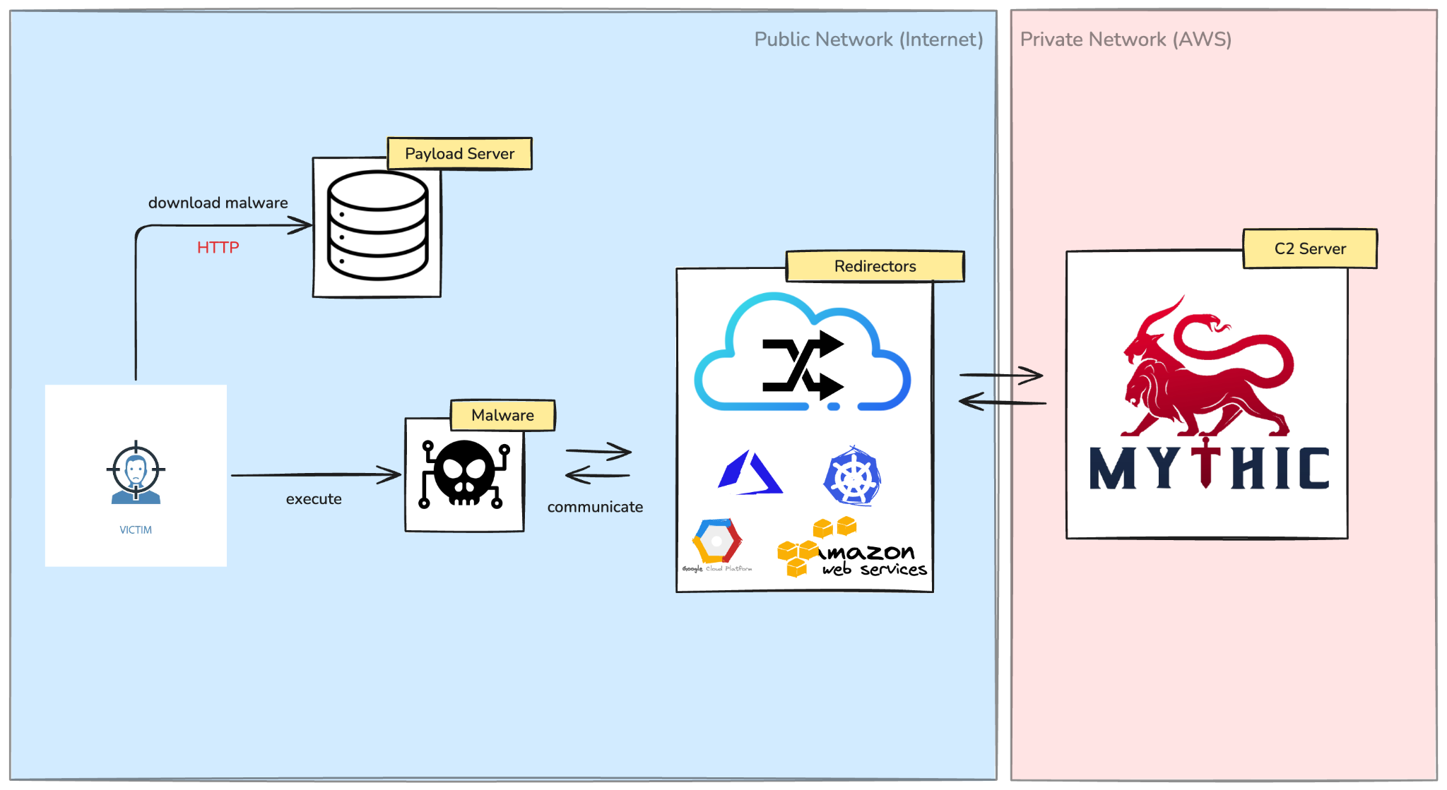
Sample Scenario: Malware Delivery

Slide 5
Our Campaign Activities
Breach the system, as deep as possible.
Achieve the objectives.
Stay undetected
And that’s why we use cryptography as enabler.

Slide 6
How do We Use Cryptography?
Practical approach!
  Choosing suitable algorithm for the case.
  Implement the algorithm correctly.
It’s rare to create new algorithm or breaking existing one.

Slide 7
Cryptography for Offensive Security
From offensive perspective:
Securing the communication channel.
Protecting the payload.
Securing our infrastructure.

Slide 8
Securing Communication Channel

Slide 9
Securing Communication Channel
Communication between malware and C2.
Over HTTPS, with valid certificates and proper keys to avoid eavesdropping.
Encrypting the request and response body to avoid real-time analysis.
  Symmetric encryption, unique for each malware build.
  Optional: use session key, rotated on regular basis, derived from master key.
Certificate pinning to ensure malware connected to “legitimate” C2 server / redirector.

Slide 10
Protecting the Payload (1/)
Partial encryption of the malware
  Encrypting readable strings: callback host, port, user-agent, etc.
  Custom encryption with XOR and modified stream cipher (RC4) for speed.
  Even the key is encrypted.

Slide 11
Protecting the Payload (2/)
Steganography for hiding the payload
  Malicious code is embedded into media.
  Loader is clean, just extract the bits
  Tricky: make sure size still make sense.

Slide 12
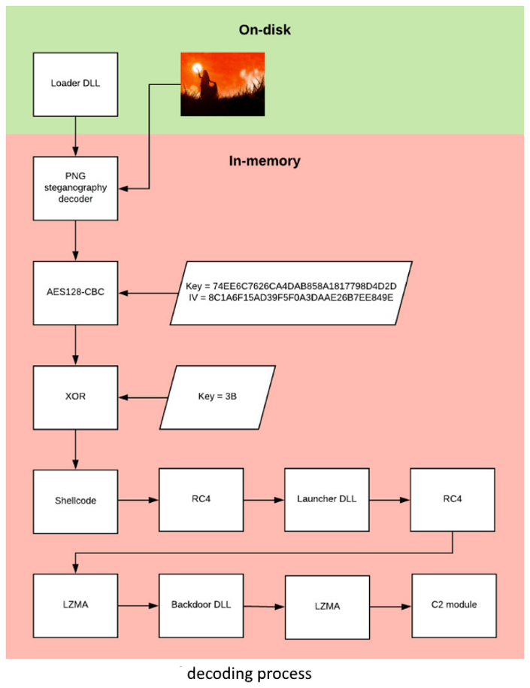
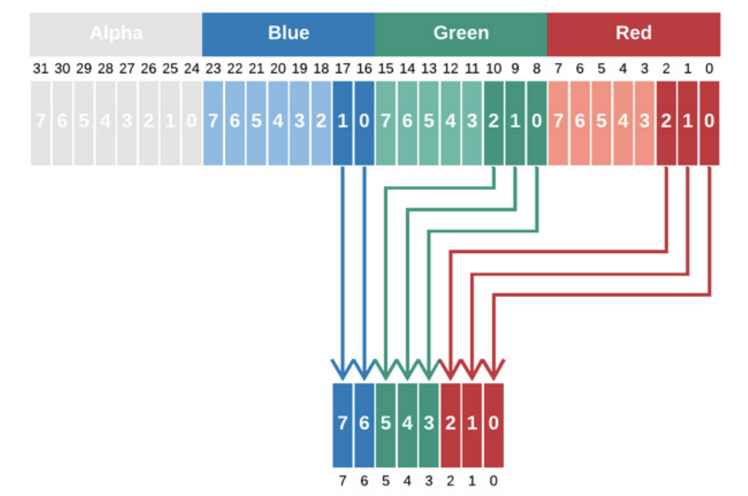
Case: OceanLotus
read analysis here

Slide 13
Securing Infrastructure (1/)
Secure Access to server (SSH)
  Use key-pair (passwordless) authentication with strong encryption.
  C2 server is not exposed, no public IP address, accessible from private network
    Connect to shell over tunnel with SSM.
  Services are listen to local only.
    Connect to service over SSH tunnel over SSM tunnel.

Slide 14
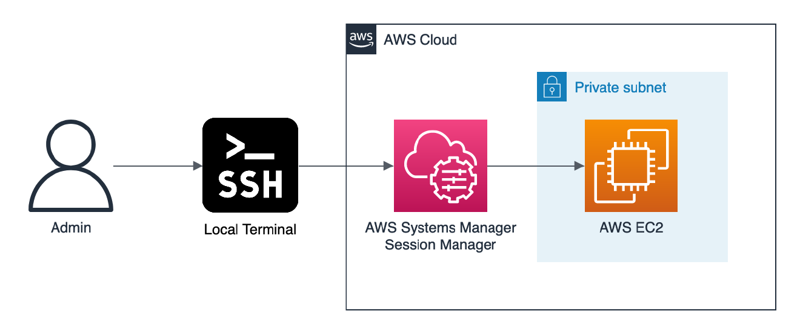

Slide 15
Securing Infrastructure (2/)
Securing Storage (EBS Volume)
  Used by EC2 instances to store intermediate data (operational data or exfiltrated data).
  Encrypt the volume by AWS-managed key or customer-managed key.
  Goal: protect from recovery outside of the running instance.

Slide 16
Securing Infrastructure (3/)
Securing Storage (S3 buckets)
  Mainly used for storing exfiltrated data.
    Alternative: CloudFlare R2 buckets
  Enforce server-side encryption.

Slide 17
Other Use Cases
Simulating ransomware (on-premise environment)
  How does ransomware encrypt files?
    mass encryption? recursive? marker?
  What is the most efficient way to encrypt?
    Hardware-assisted? Block or stream cipher? Partial or whole file encryption? key-generation?

Slide 18
Breaking and Bypassing Crypto
When cryptography fails
Weak random number generation (predictable keys).
Poor key management (hardcoded or reused keys).
Implementation bugs (e.g. OpenSSL Heartbleed).

Slide 19
Post Quantum Cryptography (1/)
When PQC implemented, we need to rethink how we use cryptography.
Shor’s Algorithm threatens asymmetric cryptography (RSA, ECC).
  Find prime factors of integer.
Grover’s Algorithm reduce brute force time from O(N) to O(√N).
  Unstructured search that finds the unique input to a black box function that produce particular output value.
Implication: harvest now, decrypt later.

Slide 20
Post Quantum Cryptography (2/)
PQC transition is not just swapping algorithms, it changes how we design and use crypto.
Now:
Hybrid cryptography approach
Some cloud providers have experimented and adopted it.

Slide 21

Useful Resources
[github] ReversingID/Crypto-Reference
[challenge] CryptoPals
[blog] cryptologie.net (David Wong)
[PQC] Open Quantum Safe

Slide 22

COME!!
ASK THE QUESTIONS

